Slide 1
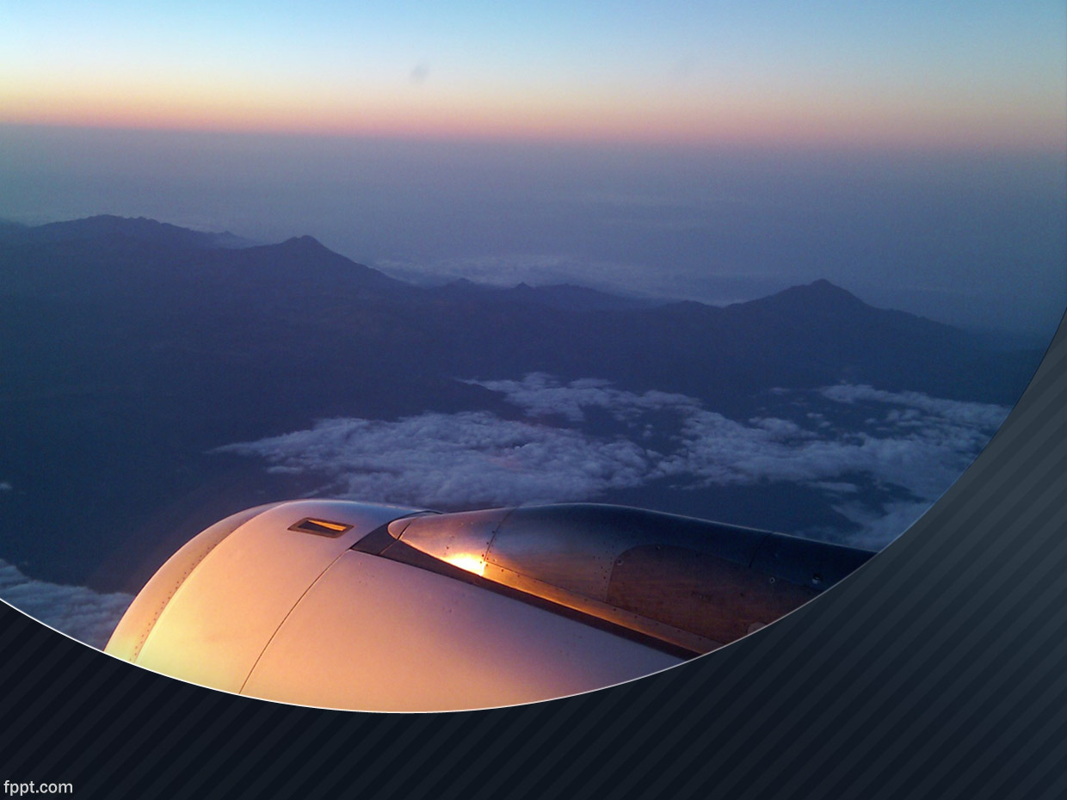
Forecast Commuters Inflow For Airline Industry
IT-B (3rd Year) G.Neha -18251A12A2 G.Likhitha -18251A12A3 Lubna Fatima -18251A12A8 M.Mahita -18251A12B0 GUIDE- C.Sudhakar Reddy

Slide 2
ABSTRACT
Air passenger traffic forecast is of great importance for airlines and civil aviation authorities.
It helps in reducing the airline’s risk by objectively evaluating the demand of the air transportation business.
The main objective of this project is to build a prophet time series model that forecasts the passenger traffic for a given date using Python, Python Frameworks and Flask.
It automatically detects changes in trends by selecting change points from the data.

Slide 3
Existing System
There are 2 approaches to time series analysis- time domain and frequency domain approach.
Existing system uses traditional statistical approaches such as econometric modelling, ARIMA etc.
Specify statistical relationship between various variables and use a no of lagged observations of time series to forecast observations.

Slide 4
Disadvantages of Existing System
Works well with only stationary data.
Prior knowledge is required.
Can’t handle data with seasonal components and irregularities.
Becomes complex and fails to predict accurately.
Real time data is often nonlinear.

Slide 5
Proposed System
Uses Time Series Analysis using Prophet library.
Eliminates the complexity.
Univariate forecast.
Prophet - doesn’t require much prior knowledge or experience of forecasting time series data.
It automatically finds seasonal trends beneath the data.
Provides time series predictions with good accuracy using simple parameters.
Includes a cross-validation function to measure forecast deviation.

Slide 6
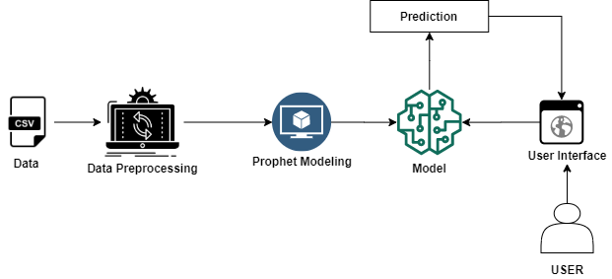
ARCHITECTURE

Slide 7
OBJECTIVES
The main objective of this project is to build prophet time series model which is easy to understand and implement for forecasting the future trends.
To forecast the demand of the air passengers for a given particular date .
To help airlines for accommodating flights and managing the expenditure on them.
To discover the pattern in the historical data series and extrapolate them into the future.
To develop an user friendly web application using flask framework.

Slide 8
Tools
Software requirements
For this project, we will be using Jupyter notebook.
Flask
Web framework used for building Web applications.
Hardware requirements
Computer with i3 or above processor.
Research Domain
Time series analysis falls under Machine learning domain.
It's an application of supervised learning and a type of regression.

Slide 9
REFERENCES
https://www.sciencedirect.com/science/article/pii/S147466701533603X
https://www.researchgate.net/publication/337969636_Decomposition_and_Forecasting_Time_Series_in_Business_Economy_Using_Prophet_Forecasting_Model/link/5dfc774c4585159aa48a592e/download
https://arxiv.org/ftp/arxiv/papers/2005/2005.07575.pdf

Slide 10
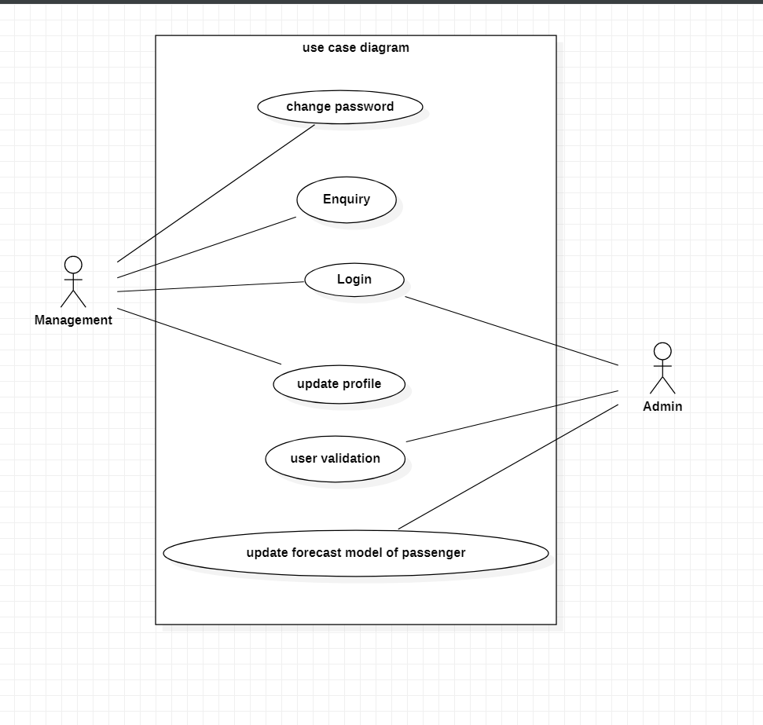
UML Diagrams
Use Case Diagram

Slide 11
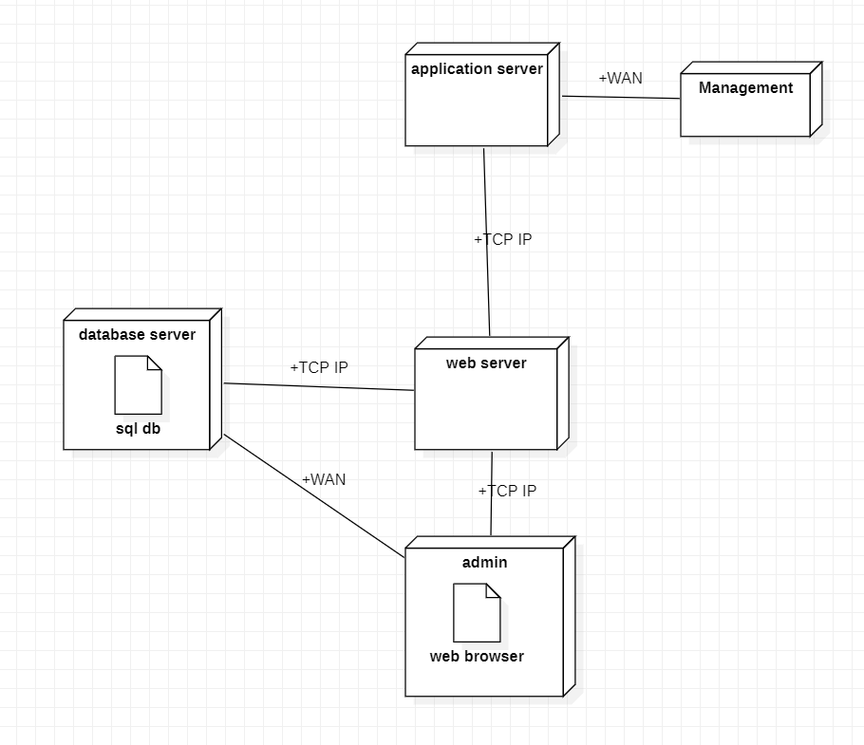
Deployment Diagram

Slide 12
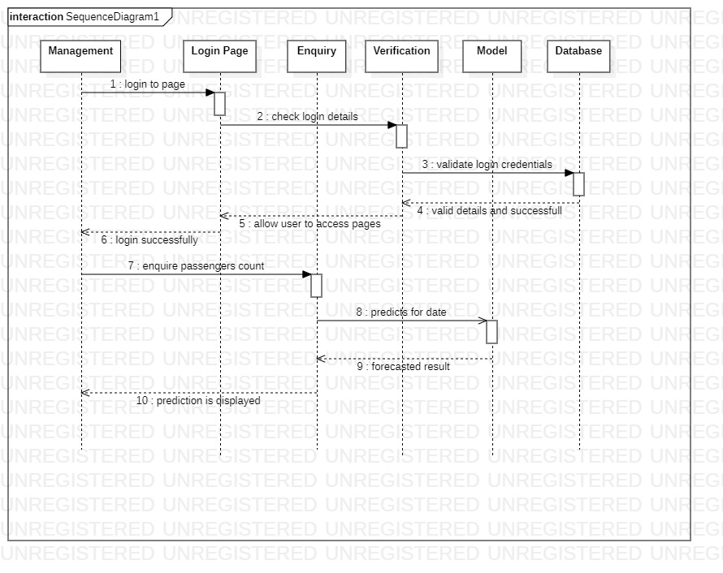
Sequence Diagram

Slide 13
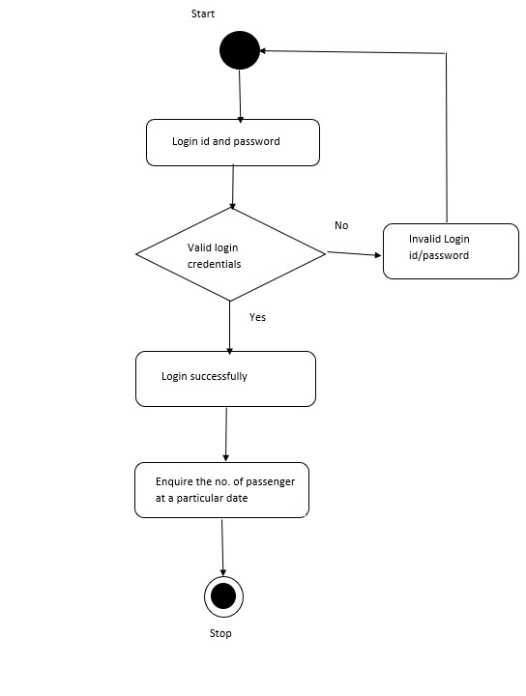
Activity Diagram for System Design

Slide 14
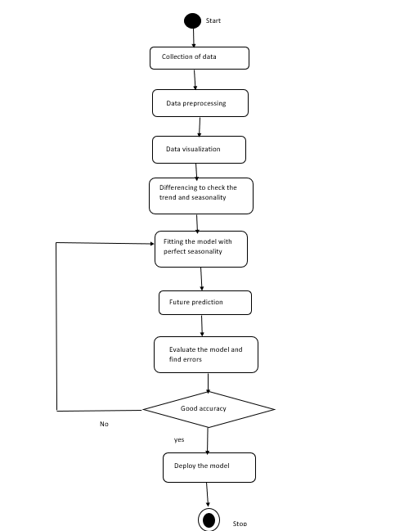
Activity Diagram for Model Design

Slide 15
THANK YOU

